Slide 1
Introduction to Computer Systems
CCE 1011

Slide 2
DATA
Organisation
Access
Analysis
Computation
Synthesis
INPUT
Human/Machine
Interface
DATA Storage
Magnetic Discs
Optical Discs
Magnetic Tapes
PROCESSING
Systems Programming
Software Organisation
Operations Handling
OUTPUT
Human/Machine
Interface
CCE1011_07_1.1

Slide 3
Human Machine Interface
Machine is electronic
Machine is binary
Human input/output
Five senses:
vision
Hearing and speech
Touch
Taste
Smell
Special input/output units to adapt and convert between humans
and machine
CCE1011_07_1.2

Slide 4
Electronic Digital System
Requires electronic building blocks for operation.
Requires boolean mathematics for analysis and design.
Requires systems methods of interpreting binary
sequences as
either data
or program instruction
CCE1011_07_1.3

Slide 5
Data Processing
The computer is a state sequential machine.
States give rise to machine cycles.
Machine cycles make up machine instructions.
Systems programming interface higher level program languages
to the machine instructions.
Millions of instructions per second can be handled.
Processor architecture handles simultaneous instruction
processing using pipelining or parallel paths.
Systems organisation handles movement of data and instructions
in and out of the processing unit
Data codes and standards interpret binary sequences into
characters, pixels, audio, etc depending on the I/O device
CCE1011_07_1.4

Slide 6
Data Storage
Volatile storage in RAM – order of few GB
Permanent Read/Write Storage – Hard Disk hundreds of GB
Transportable Storage – CD hundreds of MB
-- DVD tens of GB
-- USB storage device GB
Database Management Systems (DBMS) to store and access
data quickly and reliably.
Data storage includes text, vision, audio, general multimedia.
CCE1011_07_1.5

Slide 7
Data Communications
Processing possible on remote machines.
Client-Server Model – Local Area Networks (LAN)
Virtual worldwide processing via Internet.
Personal Multimedia access via wireless electronic equipment
– mobiles, wireless LAN’s, GSM.
Voice, pictures, videos and data streaming in real-time using
the same common backbone telecommunications
infrastructure.
CCE1011_07_1.6

Slide 8
Architecture & Organization 1
Architecture is those attributes visible to the programmer
  Instruction set, number of bits used for data representation, I/O mechanisms, addressing techniques.
  e.g. Is there a multiply instruction?
Organization is how features are implemented
  Control signals, interfaces, memory technology.
  e.g. Is there a hardware multiply unit or is it done by repeated addition?
Stallings_COA7e1_2

Slide 9

Functional View
Stallings_COA7e1_6

Slide 10
Structure - Top Level
Peripherals
Computer
Central
Processing
Unit
Main
Memory
Computer
Systems
Interconnection
Input
Output
Communication
lines
Stallings_COA7e1_11

Slide 11
Structure - The CPU
CPU
Computer
Arithmetic
and
Login Unit
I/O
Registers
System
Bus
CPU
Internal CPU
Interconnection
Memory
Control
Unit
Stallings_COA7e1_12

Slide 12
von Neumann/Turing
Stored Program concept
Main memory storing programs and data
ALU operating on binary data
Control unit interpreting instructions from memory and executing
Input and output equipment operated by control unit
Princeton Institute for Advanced Studies
  IAS
Completed 1952
Stallings_COA7e2_4

Slide 13

Structure of von Neumann machine
Stallings_COA7e2_5

Slide 14
IAS - details
1000 x 40 bit words
  Binary number
  2 x 20 bit instructions
Set of registers (storage in CPU)
  Memory Buffer Register
  Memory Address Register
  Instruction Register
  Instruction Buffer Register
  Program Counter
  Accumulator
  Multiplier Quotient
Stallings_COA7e2_6

Slide 15

Structure of IAS –
detail
Stallings_COA7e2_7

Slide 16
Special Registers
MAR – Memory address Register is a processor register that contains the address of the memory location being or to be accessed
MBR – Memory Buffer (Data) Register is a processor register that contains the data to be written to memory or where the data read from memory is stored
PC – Program Counter is a processor register that contains the start address in memory of the next instruction to be executed
IR – Instruction Register contains a copy of the instruction operand fetched from memory
ACC – Accumulator is a register associated with the ALU that is used as a working register to store operands that are to be used in the ALU.
CCE1011_07_1.7

Slide 17
A register is a group of binary storage cells or flipflops. Registers usually have
parallel load enable and are synchronised in their timing operation by a clock
input
Parallel loading
Clock input
4-bit register
Enable control line
The 4-bit register above can have its four cells loaded in parallel, if the
Enable is active and when the clock is active.
Computer registers started as 4-bit registers and today they are 64-bit
Registers.
CCE1011_07_1.8

Slide 18
Memory
A memory location is distinguished
by an address. At every location there
are a number of bits stored as one word.
Memory is still quoted in terms of bytes
(8 bits) but it can be organised to have
At each address 32 bits (4 bytes) or 64
bits (8 bytes)
There are 2 control lines associated
with memory access
A read control line and
A write control line.
An active read means data is being
read from memory to processor
An active write means data is written
from processor to memory
CCE1011_07_1.9

Slide 19
Main memory contains data that can be interpreted either as an instruction
Or as operand data.
This interpretation is based on the principle of the fetch – execute cycle
Of an instruction cycle.
Instruction Cycle
Fetch Cycle
(i) PC MAR; Read (from memory to MBR)
(ii) MBR IR
2. Execute cycle
(i) decode opcode of instruction
(ii) update the PC register contents for the next instruction
(iii) execute the instruction
CCE1011_07_1.10

Slide 20
Program flow
A program has associated procedures or methods
Branching to a procedure or method necessitates that present data and a return address be stored
A part of main memory called the stack is used to remember data and addresses
A stack pointer register in the processor is used to point at top of stack
CCE1011_07_1.11

Slide 21
Interrupts
Mechanism by which other modules (e.g. I/O) may interrupt normal sequence of processing
Program
  e.g. overflow, division by zero
Timer
  Generated by internal processor timer
  Used in pre-emptive multi-tasking
I/O
  from I/O controller
Hardware failure
  e.g. memory parity error
Stallings_COA7e3_12

Slide 22
Interrupt Cycle
Added to instruction cycle
Processor checks for interrupt
  Indicated by an interrupt signal
If no interrupt, fetch next instruction
If interrupt pending:
  Suspend execution of current program
  Save context
  Set PC to start address of interrupt handler routine
  Process interrupt
  Restore context and continue interrupted program
Stallings_COA7e3_14

Slide 23

Transfer of Control via Interrupts
Stallings_COA7e3_15

Slide 24

Instruction Cycle with Interrupts
Stallings_COA7e3_16

Slide 25
Advantages of Interrupts
Processor initialises an I/O operation (4)(necessary both with and without interrupts)
I/O Operation starts – without interrupts processor waits till end - with interrupts processor starts some other task (2a)
At end of I/O - without interrupts processor finishes the I/O operation (5), then starts another task (2)
with interrupts, processor receives an interrupt, stops the current task,(2a), services the interrupt to finish the I/O operation,(5), and continues the interrupted task, (2b).
CCE1011_07_1.12

Slide 26
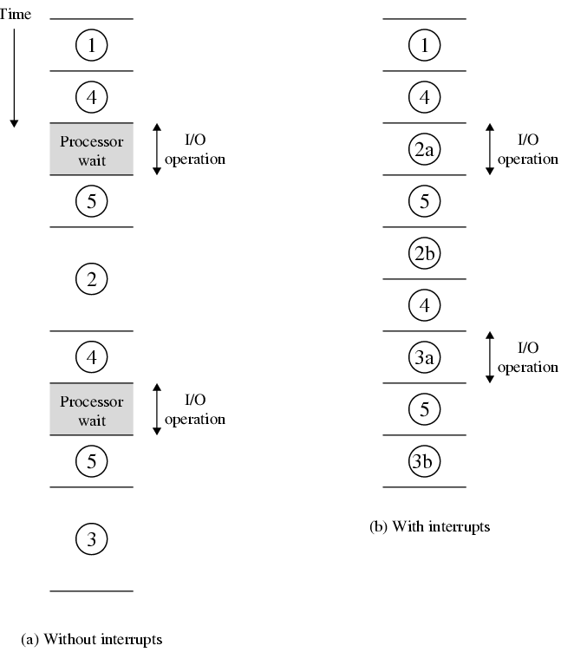
Program Timing - Short I/O Wait
Stallings_COA7e3_17

Slide 27
Multiple Interrupts
Disable interrupts
  Processor will ignore further interrupts whilst processing one interrupt
  Interrupts remain pending and are checked after first interrupt has been processed
  Interrupts handled in sequence as they occur
Define priorities
  Low priority interrupts can be interrupted by higher priority interrupts
  When higher priority interrupt has been processed, processor returns to previous interrupt
Stallings_COA7e3_20

Slide 28

Multiple Interrupts - Sequential
Stallings_COA7e3_21

Slide 29
Multiple Interrupts – Nested
Stallings_COA7e3_22

